Slide 1
Unit-4
Binary Image Processing:
Mathematical Morphology, Structuring Elements, Morphological Image processing, Basic, Set theory, Logical operations, Standard binary morphological operations,
Dilation and erosion based operations, Properties of morphological operations, Morphological algorithms - Hit and Miss, Boundary Detection, Convex Hull, Thinning, Thickening, Distance Transform.

Slide 2
Introduction
Morphology in context of image processing means description of shape and structure of the object in an image.
The primary goal of morphological operation is to remove imperfection that mainly affects the shape and texture of images.
It is obvious that morphological operations can be very useful in image segmentation as the process directly deals with ‘shape extraction’ in an image.
Morphological operations (Mathematical Morphology) work on the basis of set theory
Sets in Mathematical Morphology represents objects in an Image

Slide 3
Mathematic Morphology
It is a tool used to extract image components that are useful in the representation and description of region shape, such as-
boundaries extraction
Skeletons
Convex hull
Morphological filtering
Thinning
Pruning

Slide 4
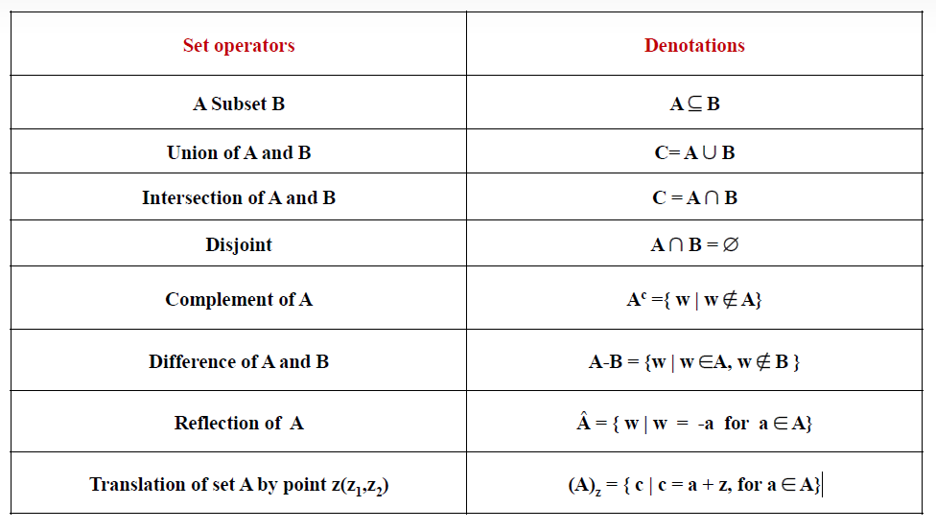
Basic Set Operations

Slide 5
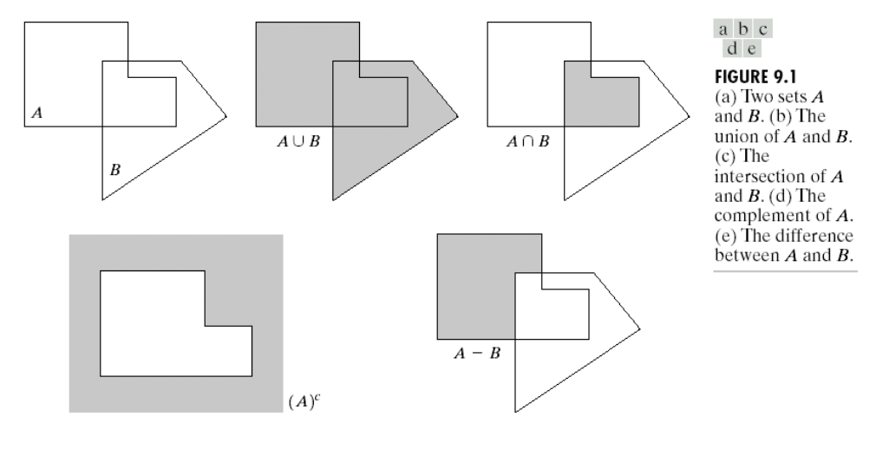
Basic Set Theory

Slide 6
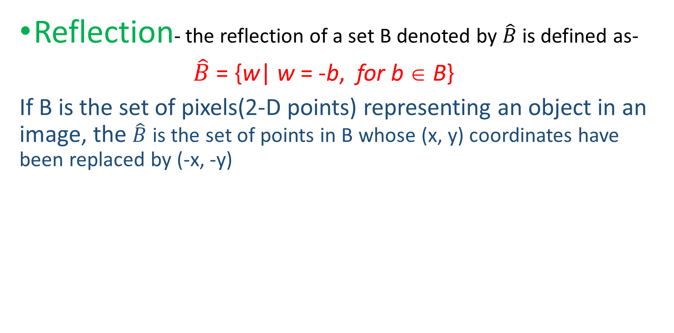
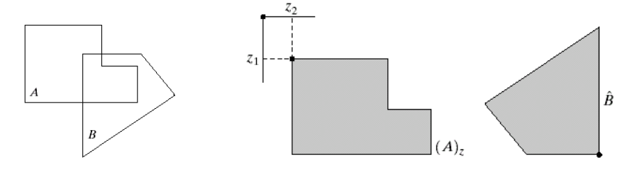
Reflection and Translation

Slide 7
Reflection and Translation
Translation – the translation of set A by points z=(z₁, z₂), denoted by (A)_{z} , is defined as-
(A)_{z} ={c|c = a + z, for a ∈ A}
If Ais the set of pixels(2-D points) representing an object in an image, the (A)_{z} is the set of points in A whose (x, y) coordinates have been replaced by (x+z₁, y+z₂)

Slide 8
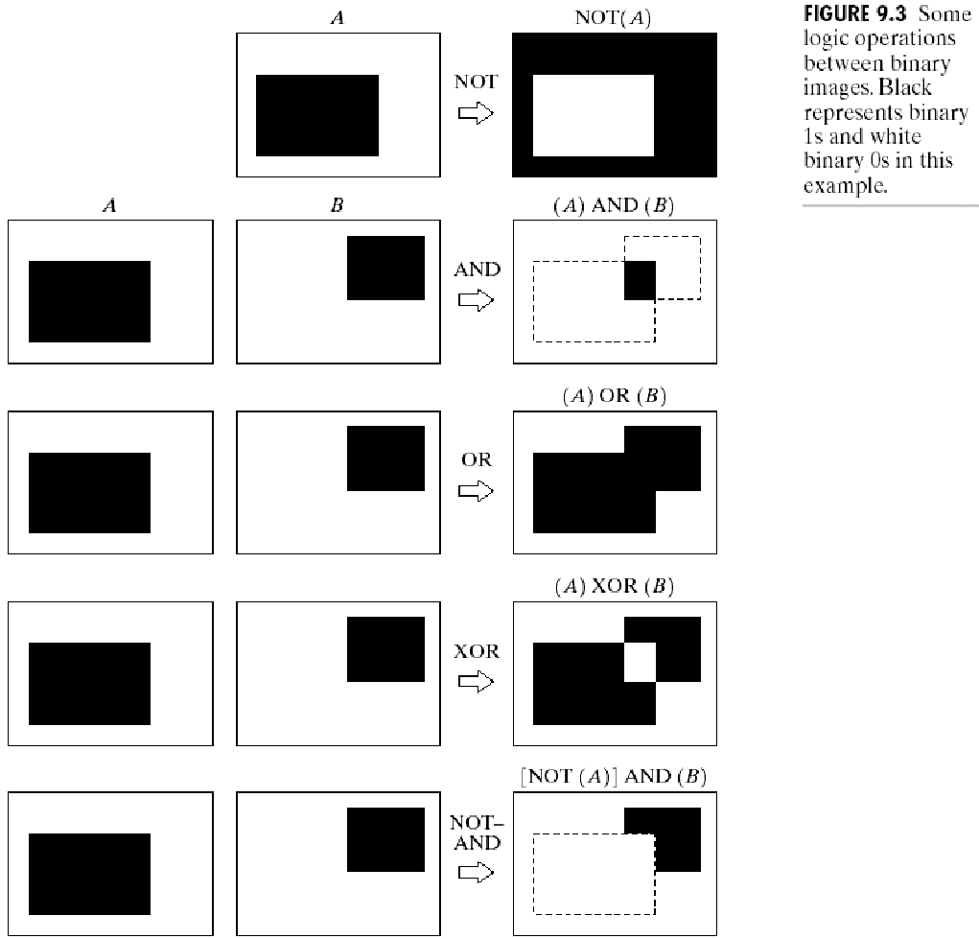
Logical Operations
A simple and effective “difference” measure is the two-input exclusive-OR operator XOR. The XOR takes logical value '1' only if its two inputs are different.

Slide 9
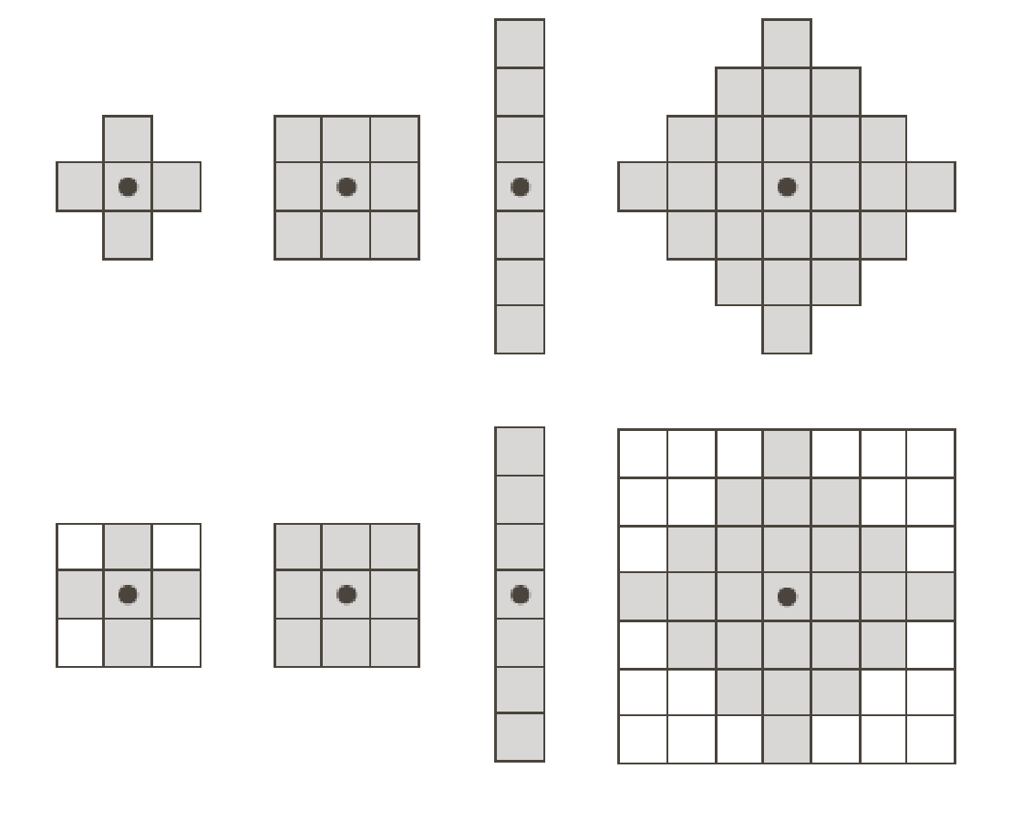
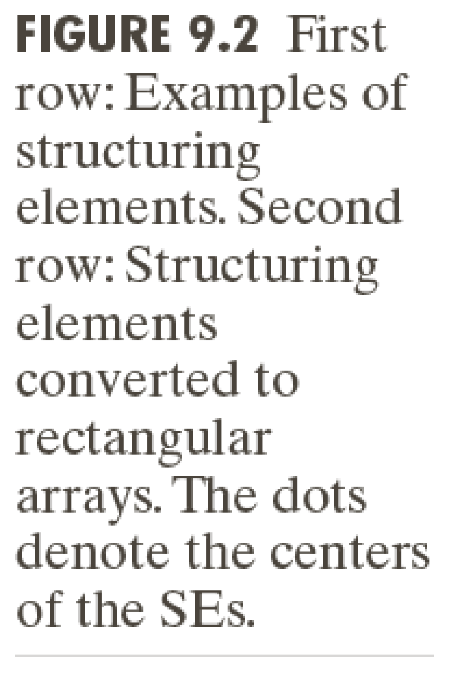
STRUCTURING ELEMENTS (SE)
Structuring elements are small sets in matrix form or a sub-image used to interact with the image to be probed.
Origin

Slide 10
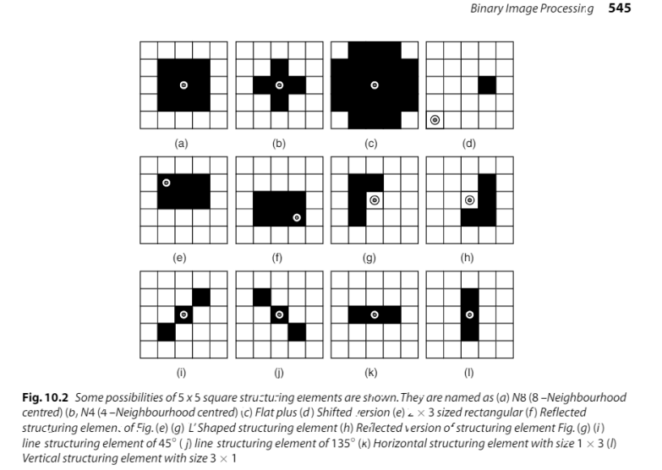
STRUCTURING ELEMENTS (SE)

Slide 11
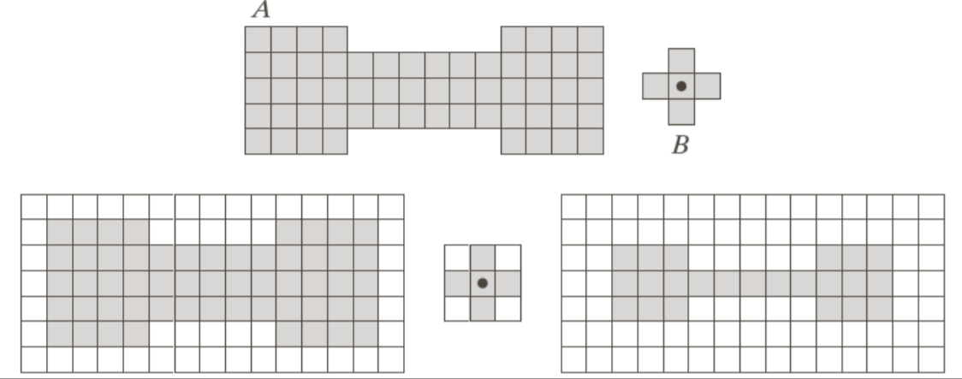
How Structuring Elements are used
The Background border is made large enough to accommodate the entire structuring element when its origin is on the border of the original set (Padding)
Suppose that we define an operation on set A using Structuring Element B, as follows: create a new set by running B over A such that the origin of B visits every elements of A. At each location of the origin of B, if B is completely contained in A, mark that location as a member of new set else mark it as not a member.

Slide 12
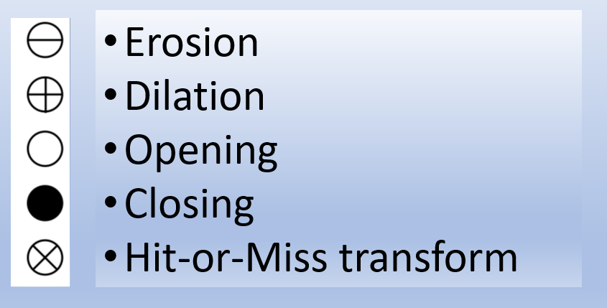
Five Binary Morphological Operations

Slide 13
Erosion and Dilation
Many of the morphological algorithms are based on these two primitive operations
Erosion (Shrink): With A and B as sets in Z ² , the erosion of A by B is defined as,
A ⊖ B = {z| (B)_{z} ∈A }
Erosion of A by B is the set of all points z such that B, translated by z, is contained in A.
A ⊖ B = {z| (B)_{z} ∩ A^{c} = ∅}
B has to be contained in A is equivalent to B not sharing any common elements with the background

Slide 14
Erosion
The erosion process enlarges the number of pixels with value zero (background) and shrinks the number of pixels with value one (foreground).
The erosion operation removes those structures which are lesser in size than that of the structuring element. So it can be used to remove the noisy ‘connection’ between two objects.

Slide 15
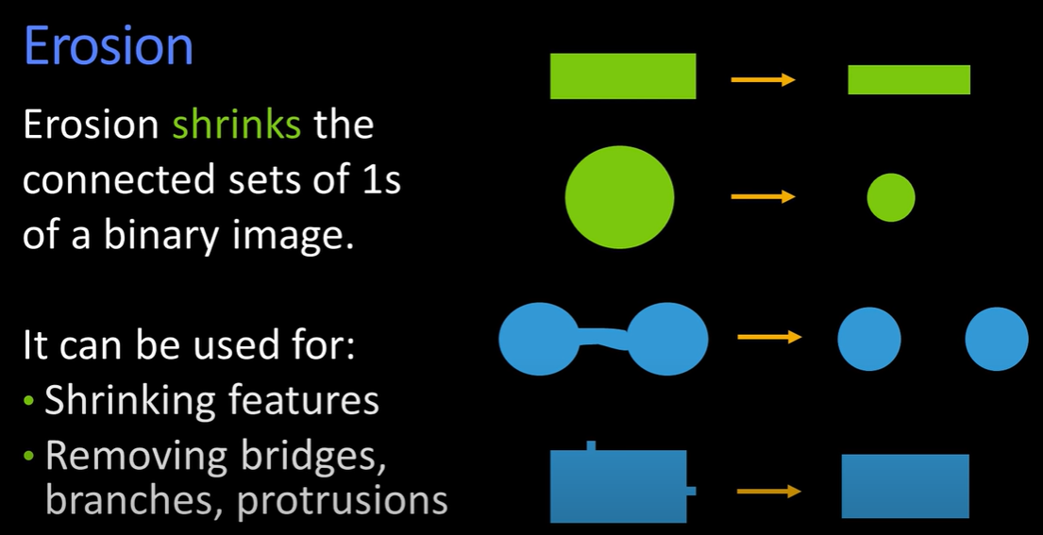

Slide 16
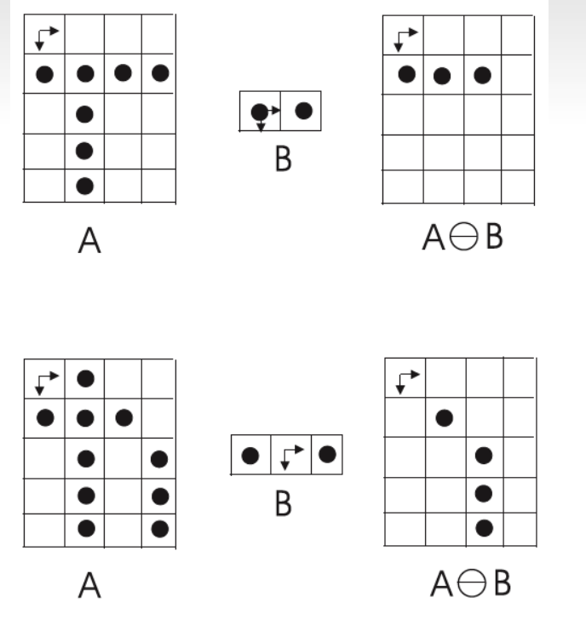
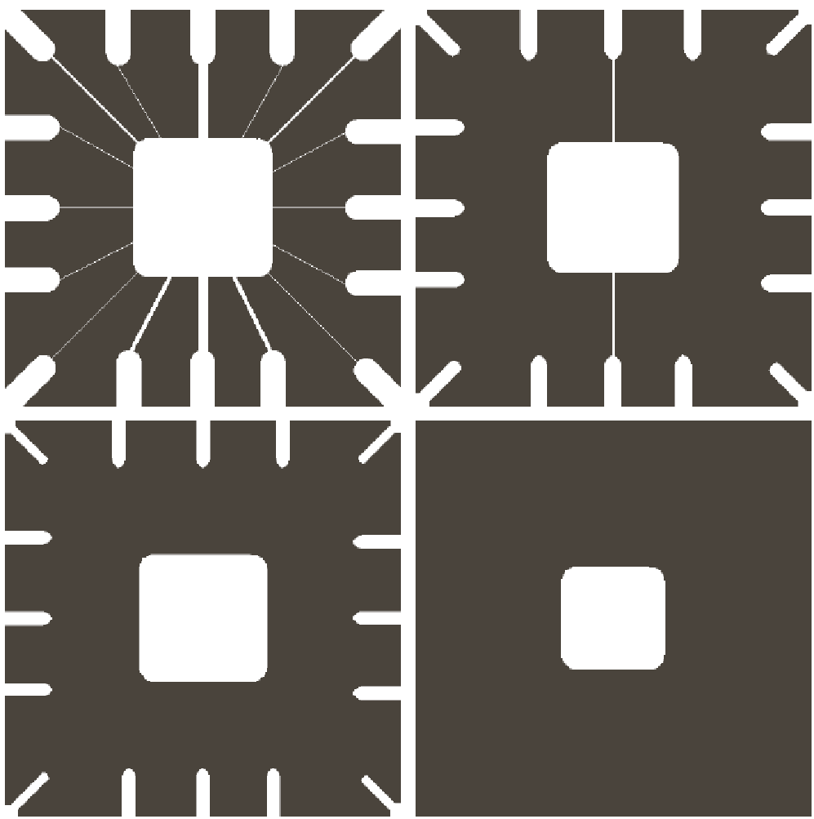
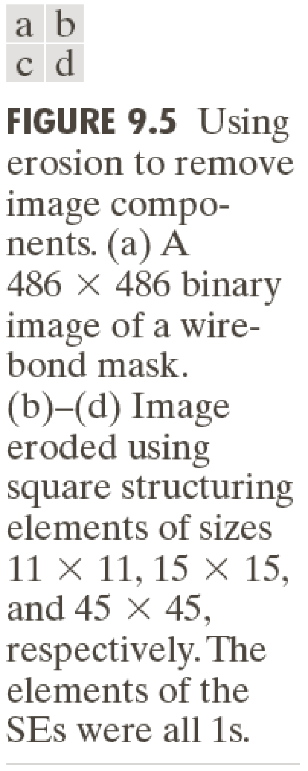
Erosion

Slide 17
Erosion
Erosion shrinks or thins objects in a binary image
Erosion as a morphological filtering operation in which image details smaller than the structuring elements are filtered from the image
Erosion performed the function of a “line filter”

Slide 18
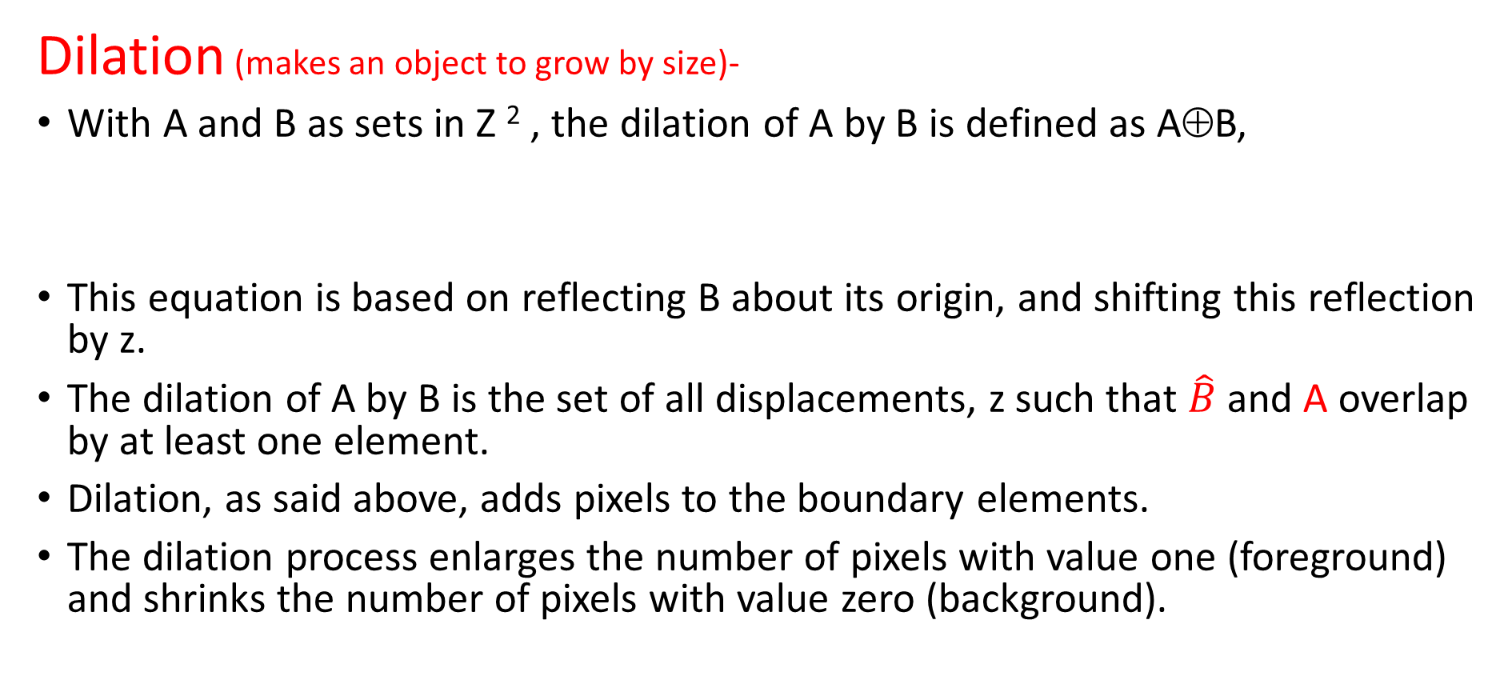
Dilation

Slide 19
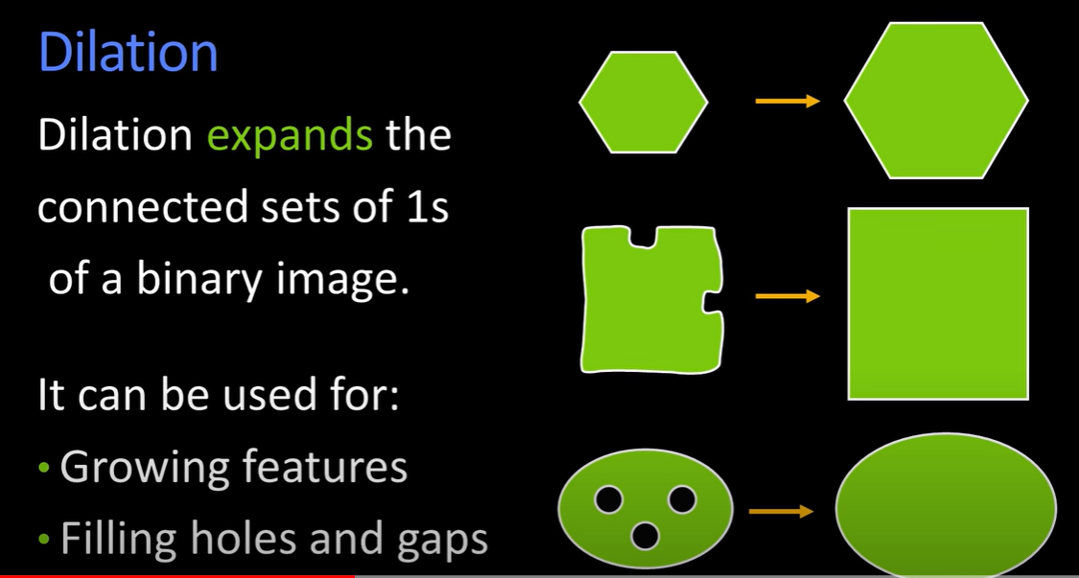

Slide 20
Dilation
A =[0 0 0 0 0
0 1 1 1 0
0 1 1 1 0
0 1 1 1 0
0 0 0 0 0 ]
B=[0 1 0
1 1 1
0 1 0]

Slide 21
Opening and Closing
Opening is so called because it can open up a gap between objects connected by a thin bridge of pixels. Any regions that have survived the erosion are restored to their original size by the dilation
Closing also tends to smooth sections of contours but, as opposed to opening, it generally fuses narrow breaks and long thin gulfs, eliminates small holes, and fills gaps in the contour. Closing is so called because it can fill holes.

Slide 22
Opening
The opening of an image is a combinational operation of erosion and dilation.
Opening of set A by Structuring Element(B)is defined as –
AoB =(A ⊖ B ) ⊕ B
Thus, opening A by B is the erosion of A by B, followed by a dilation of the result by B
Opening is an idempotent operation: once an image hasbeen opened, subsequent openings with the same structuring element have no further effect on that image:
(AoB) o B= AoB

Slide 23
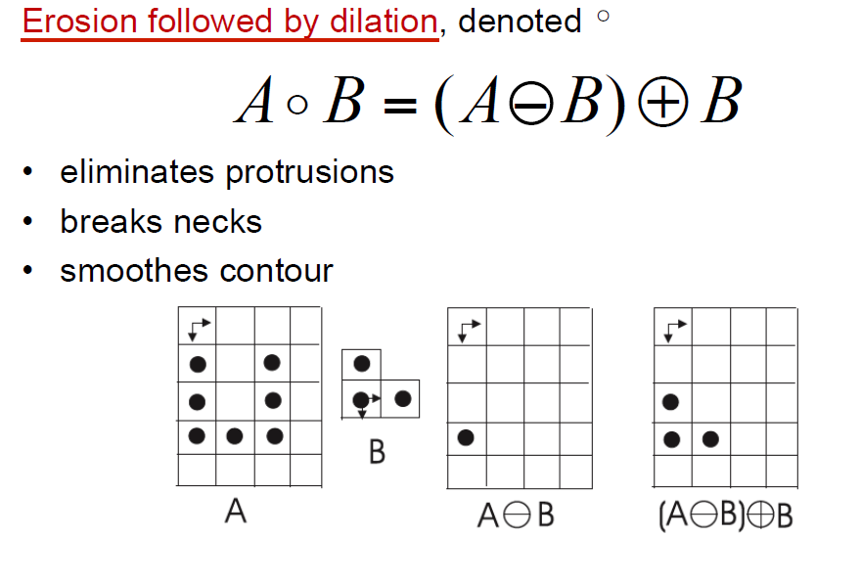
Opening

Slide 24
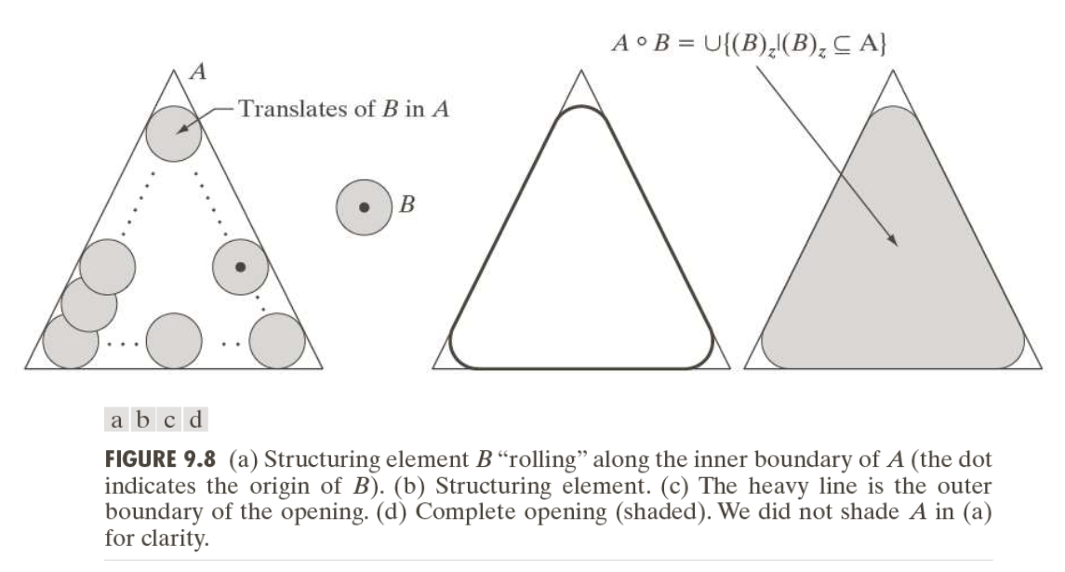
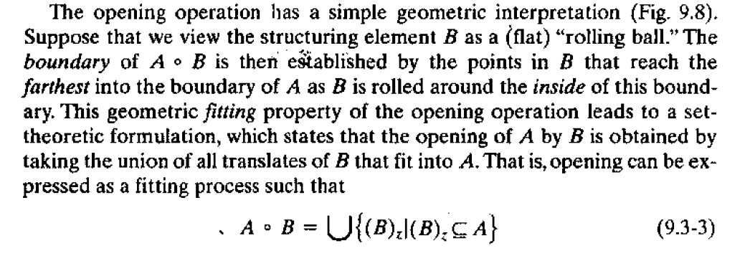
Opening

Slide 25
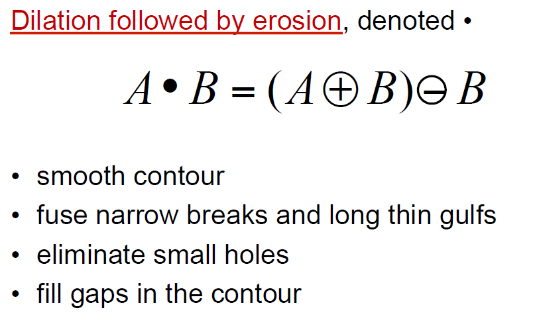
Closing

Slide 26
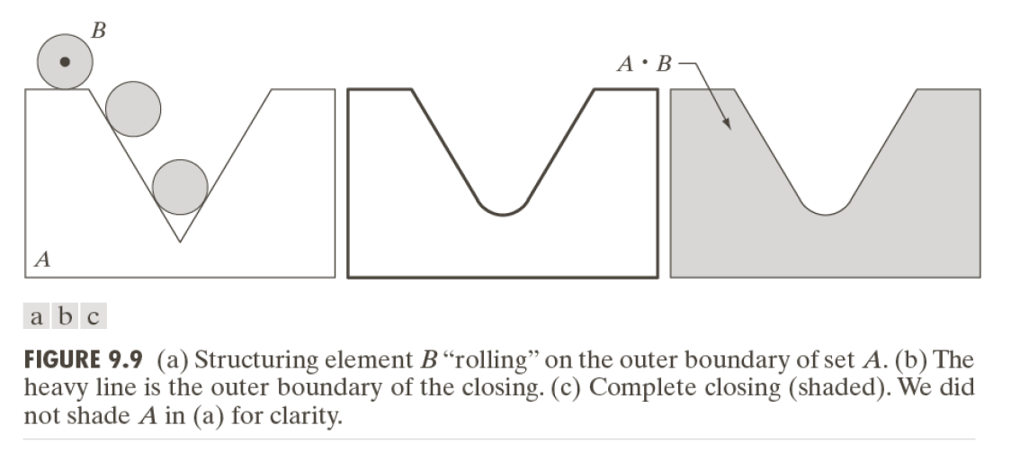
Closing

Slide 27
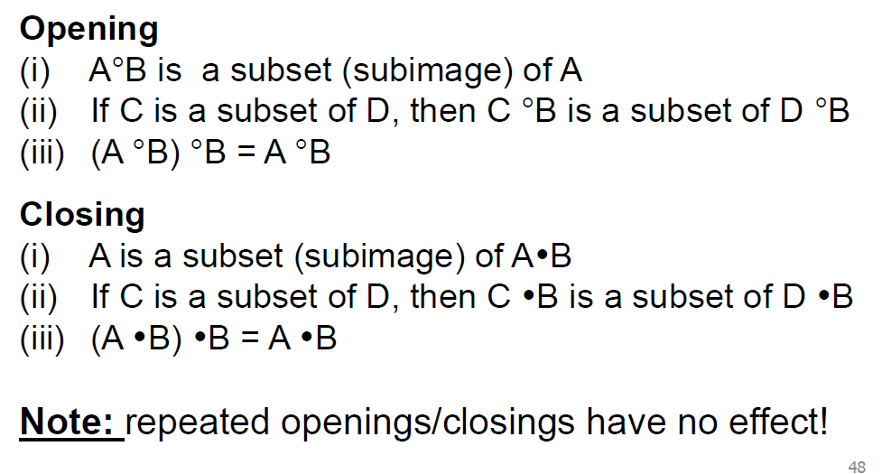
Properties

Slide 28
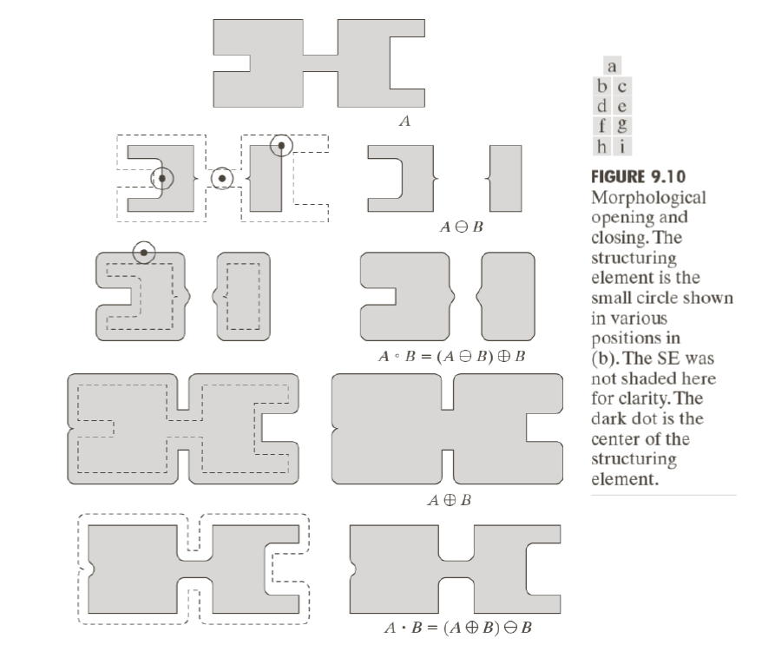
Opening and Closing

Slide 29
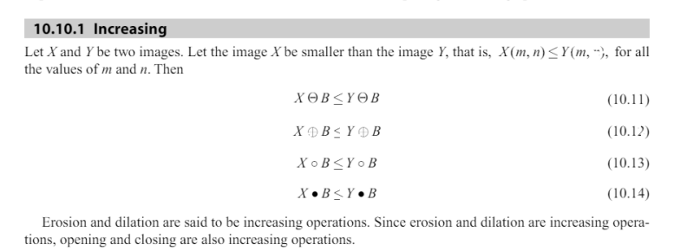
Properties of Morphological operations

Slide 30

Properties of Morphological operations
Erosion is anti-expansive, i.e the no of one’s present in the output eroded image is less as compared to the original image.
Dilation is expansive.

Slide 31

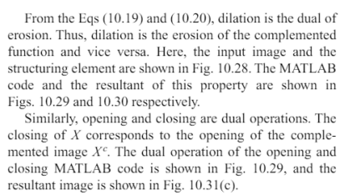
Properties of Morphological operations

Slide 32
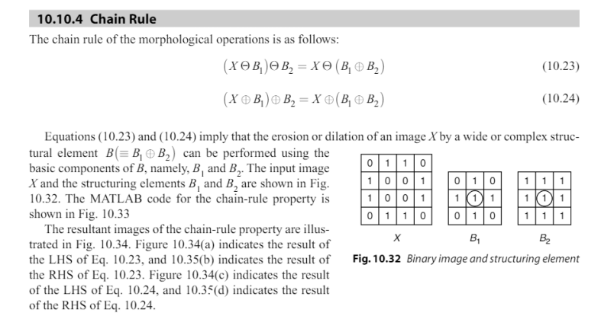
Properties of Morphological operations

Slide 33
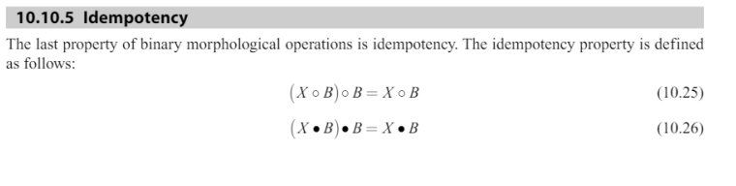
Properties of Morphological operations

Slide 34
Hit-or-Miss Transformation
The hit-or-miss transform is a general binary morphological operation that can be used to look for particular patterns of foreground and background pixels in an image.
The hit-and-miss transform is a basic tool to detect or locate an object of given size or shape in an image.
Concept: To detect a shape:
Hit object
Miss background

Slide 35
Hit-or-Miss Transformation
The hit and miss transform allows to derive information on how objects in a binary image are related to their surroundings.
The operation requires a matched pair of structuring elements, {B₁, B₂}, that probe the inside and outside, respectively, of objects in the image:
composite SE: object part (B₁) and background part (B₂)
the reason for using structuring element B₁ associated with object and B₂ associated with the background is based on the assumed definition that two or more objects are distinct only if they form disjoint sets

Slide 36
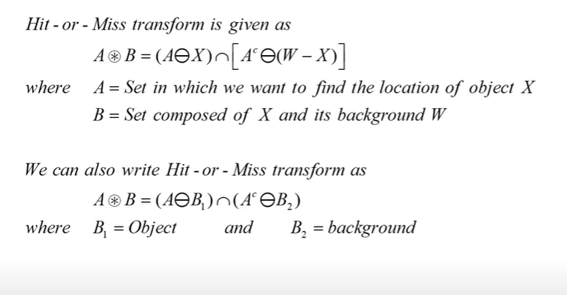

Slide 37
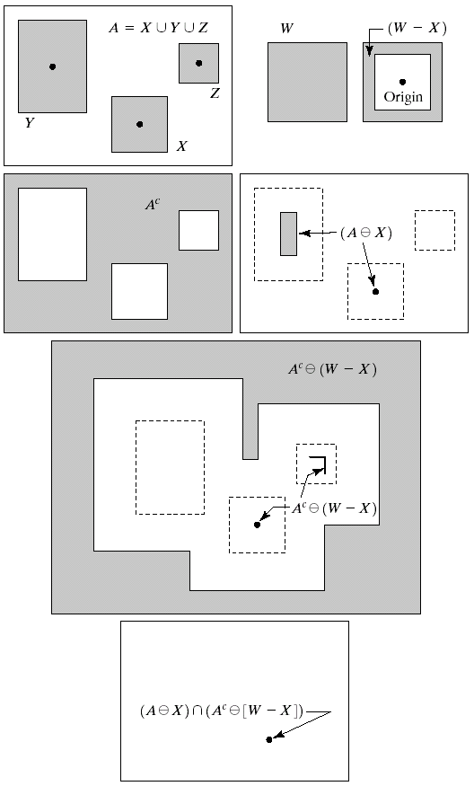
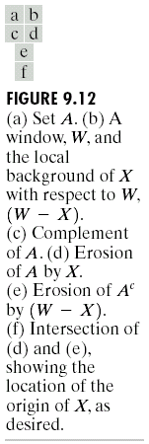
Hit-or-Miss Transformation

Slide 38
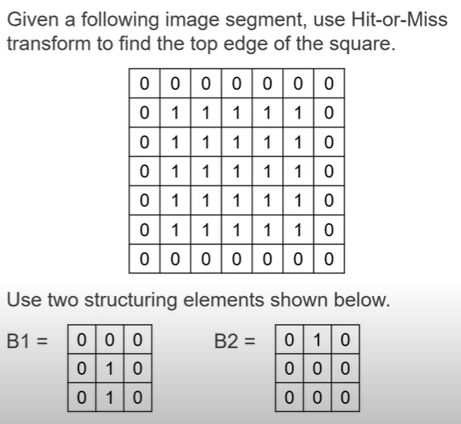
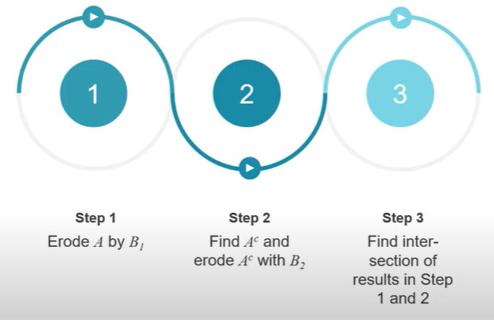
Hit and Miss - Example 1

Slide 39
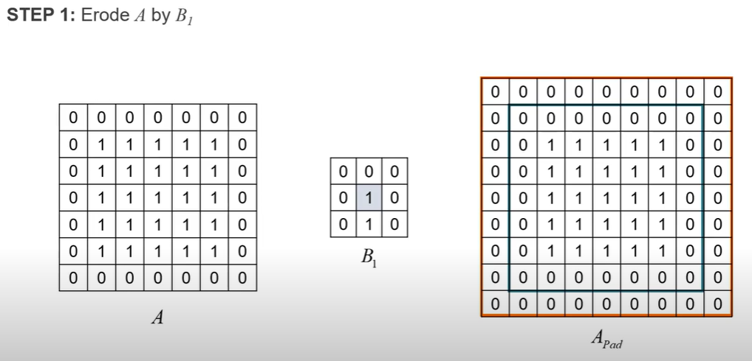
Hit and Miss - Example 1

Slide 40
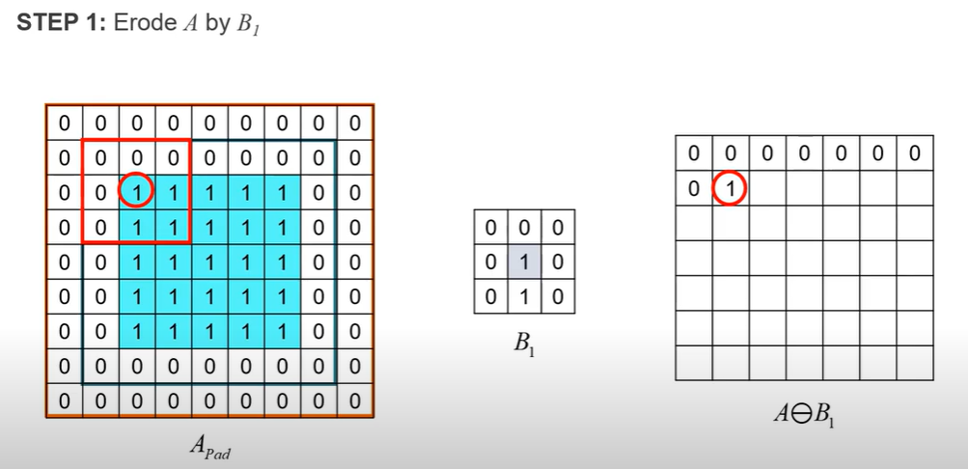
Hit and Miss - Example 1

Slide 41
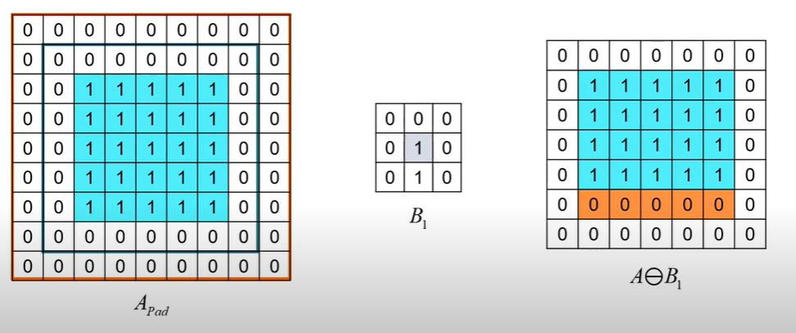
Hit and Miss - Example 1

Slide 42
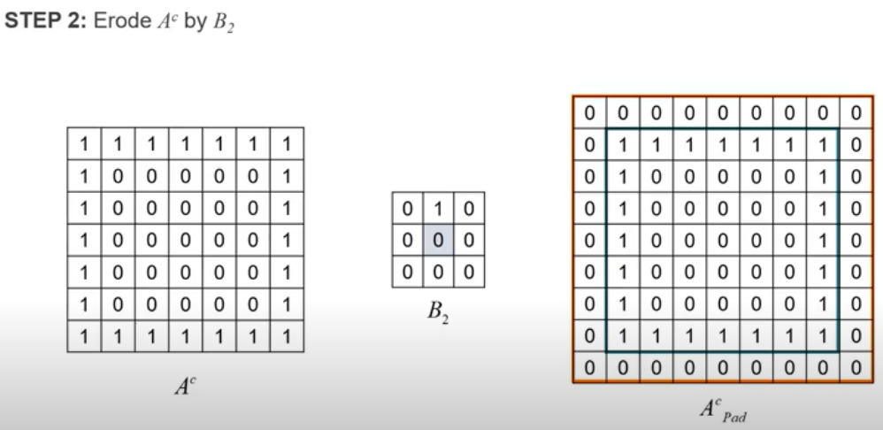
Hit and Miss - Example 1

Slide 43
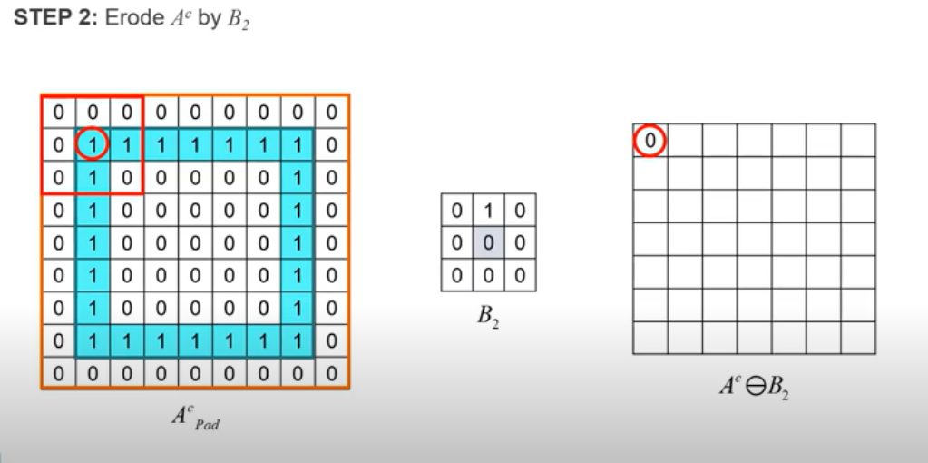
Hit and Miss - Example 1

Slide 44
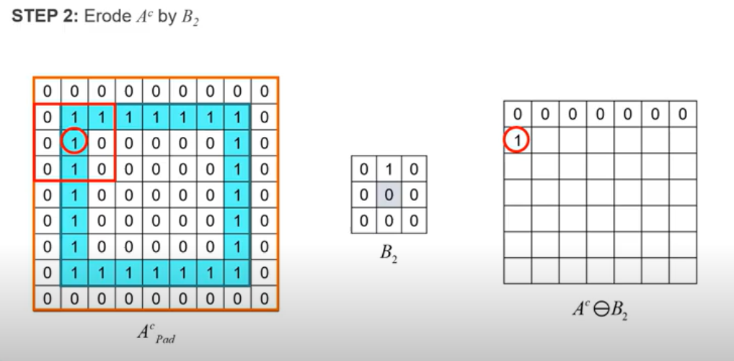
Hit and Miss - Example 1

Slide 45
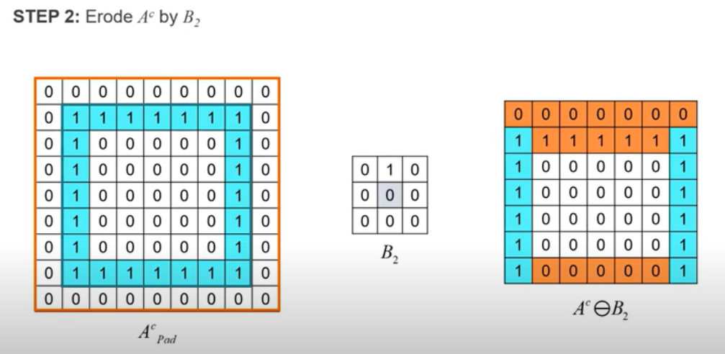
Hit and Miss - Example 1

Slide 46
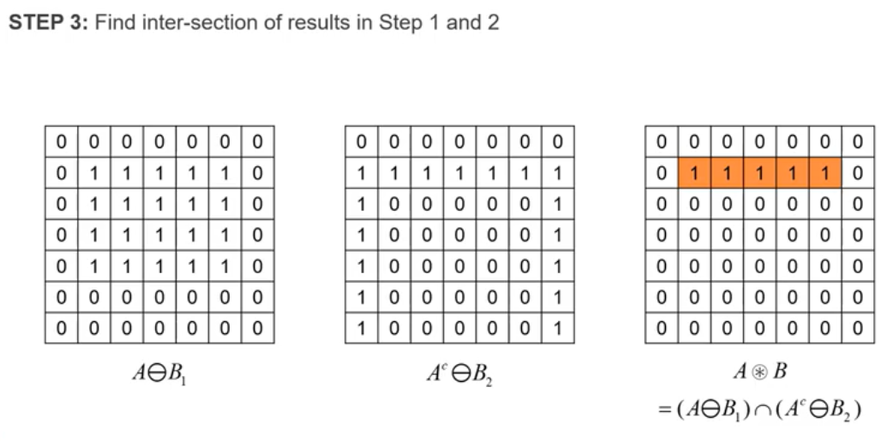
Hit and Miss - Example 1

Slide 47
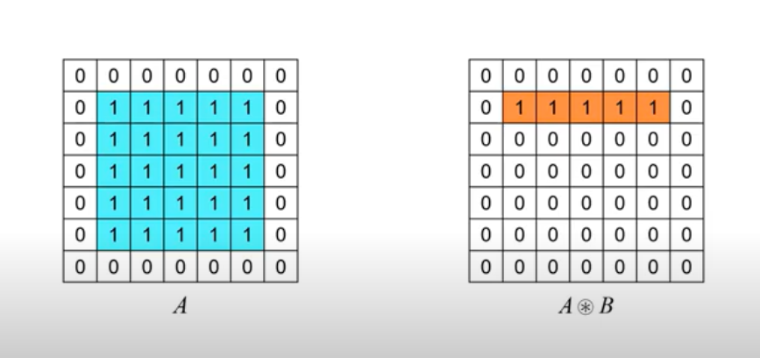
Hit and Miss - Example 1

Slide 48
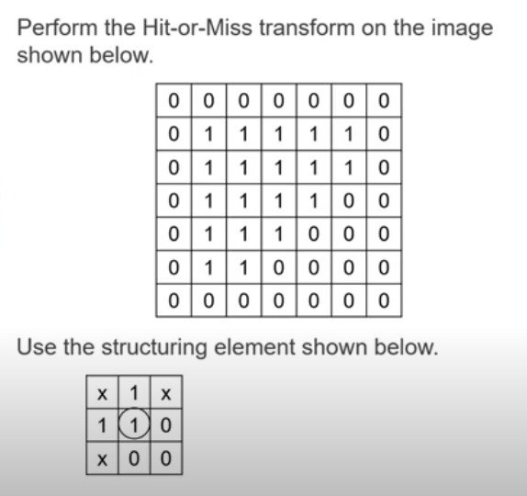
Hit and Miss - Example 2

Slide 49
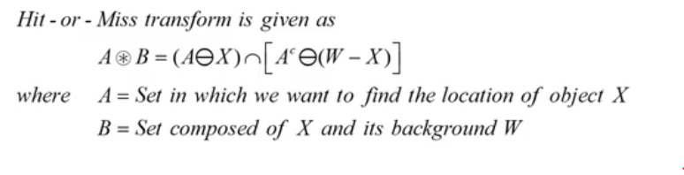
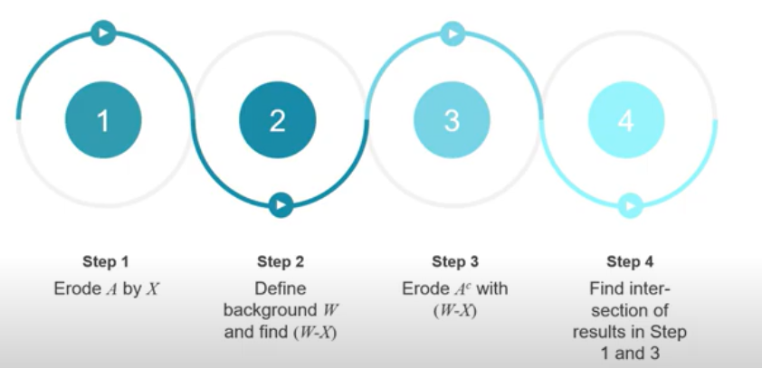
Hit and Miss - Example 2

Slide 50
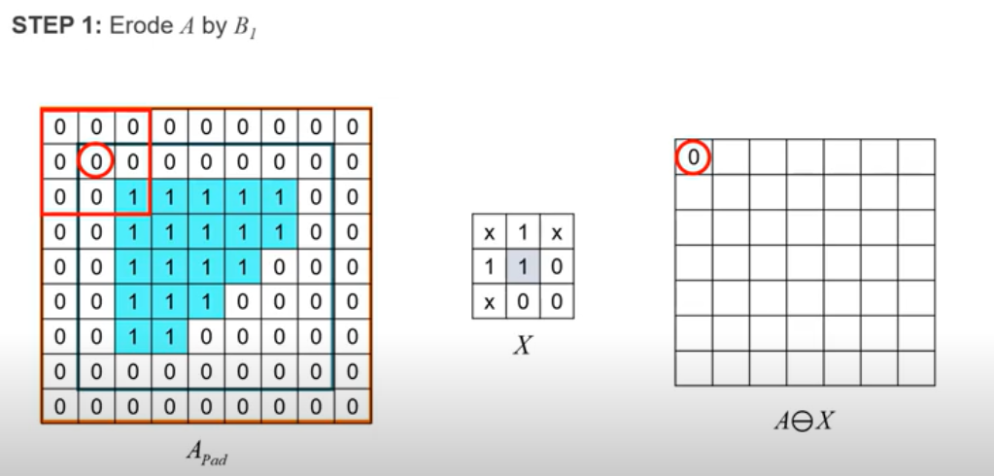
Hit and Miss Hit & Miss- Example 2

Slide 51
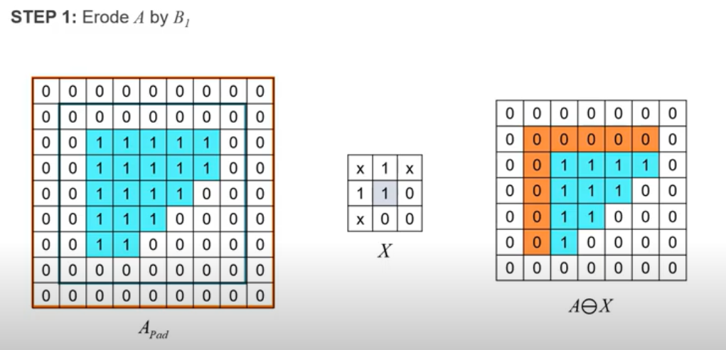
Hit and Miss - Example 2

Slide 52

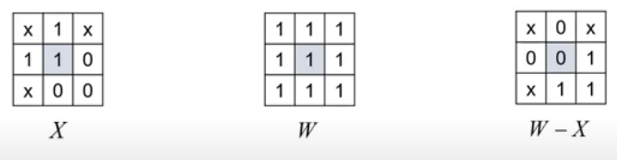
Hit and Miss - Example 2
Step-2 Define background W and find (W-X)

Slide 53
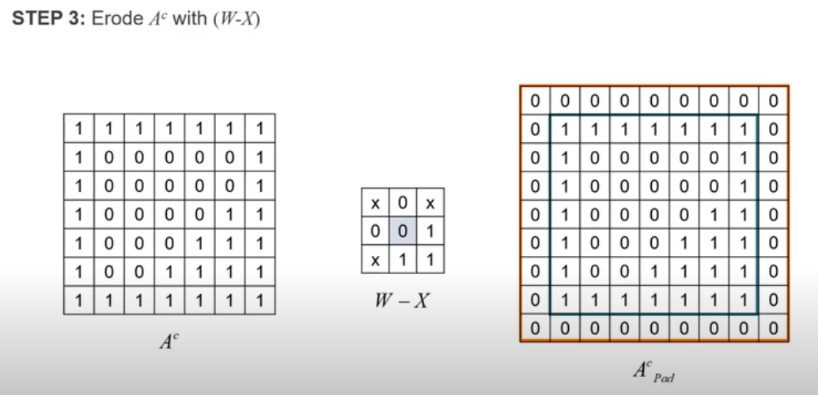
Hit and Miss - Example 2

Slide 54
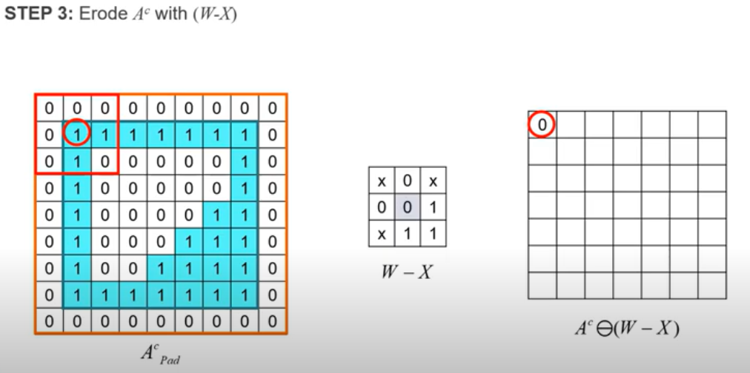
Hit and Miss - Example 2

Slide 55
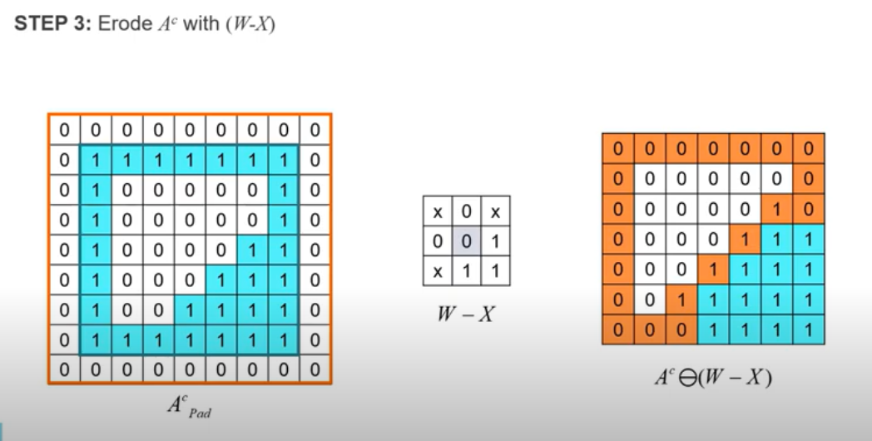
Hit and Miss - Example 2

Slide 56

Hit and Miss - Example 2

Slide 57

Hit and Miss - Example 2

Slide 58

Some basic Morphological algorithms
Boundary Extraction-

Slide 59

Boundary Extraction-

Slide 60
Matlab Code- Boundary extraction
pkg load image;
#Read input image
org_im = imread(coins.png');
figure 1, imshow(org_im); title('Original Image');
#Convert RGB image to Binary Image and Displayed as Input Image
A=im2bw(org_im);
se=strel('disk',1,0);
F=imerode(A,se);
figure 2, imshow(F);title("eroded");
figure 3, imshow(A-F); title("boundary");

Slide 61

Boundary extraction - Output

